Slide 1
Medicaid and Jails
Optimizing Resources and Strengthening Reentry
October 2019
Suzanne Gore, JD, MSW, Principal, State Health Partners
Raynette Adams, Medicaid Corrections Liaison, DMAS

Slide 2
Overview
Medicaid’s Importance to Jails
What Medicaid Covers in Jails
What is New in Medicaid
2017 Legislative Direction
2019 Medicaid Application Process
Important Information & FAQs
Accessing Medicaid Eligibility Information
Work in Process
Resources

Slide 3
Medicaid’s Importance to Jails

Lower Hospitalization Costs for Jails
        Medicaid can pay for inpatient hospital care when a Medicaid-enrolled inmate is hospitalized or expected to be hospitalized for at least 24 hours.
Reduce recidivism - especially for individuals with behavioral health or substance use disorder needs.

Support Reentry and Reduce Recidivism

Slide 4
Medicaid’s Importance to Jails

Jails are Required to Provide Healthcare
Jails have a Constitutional duty to provide healthcare (8th Amendment).
High prevalence of mental illness and substance use disorders in jails.
Jails are NOT required to cover preexisting conditions.
This impacts access to hospital care.
Inmates are responsible for payment, typically with no source of income and no health coverage.

Preexisting Conditions

Slide 5
What Medicaid Covers In Jails
When can Medicaid pay for inmate health care?
Federal Medicaid funding for inmates is only available for inpatient services furnished in a medical institution (including services furnished by such providers during the inpatient stay). §1905(a)(29)(A) of the Social Security Act.
Medical Institution Stay: Defined in federal regulations (42 C.F.R. 435.1010) as “a stay of 24 hours or more in which there is an admission of the individual to the facility as an inpatient on the orders of the practitioner responsible for the care of the patient.” (An observation stay does NOT meet this requirement)

Slide 6
What Medicaid Covers In Jails
Medicaid cannot cover outpatient services for inmates, including but not limited to services in a local hospital emergency department, an urgent care center, a clinic, or a Federally Qualified Health Center/Rural Health Clinic.
Medicaid will also not cover services furnished in a correctional institution to an inmate.
Medicaid will also not cover “Observation Stays.” These are stays that do not meet medical necessity requirements for an Admission, even though the patient may stay overnight.

Slide 7
What is New in Medicaid
As of January 1, 2019, almost all inmates qualify for Medicaid
Virginia Medicaid rules changed on January 1, 2019.
Up to 400,000 more Virginia adults are now eligible for health coverage and 300,000 have enrolled to date.
For people in the community, Medicaid covers medical care, mental health, substance use disorder treatment, and long-term services and supports.
Incarcerated coverage only covers inpatient coverage.

Slide 8
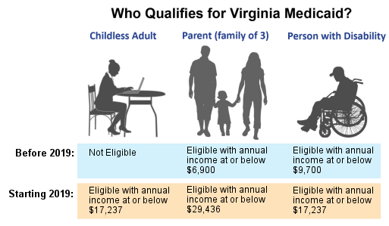
What is New in Medicaid
Adults ages 19-64
Income from 0% to 138% Federal Poverty Level
Most inmates will qualify as a “Childless Adult.” This is a new eligibility group through Medicaid Expansion.

Slide 9

What is New in Medicaid
Medicaid Expansion Funding: State and Federal
Virginia must still determine which eligibility “group” enrollees qualify for since different groups have different federal match rates
Medicaid is jointly funded by the federal and state governments
In Virginia, the federal government typically pays 50% of Medicaid costs
Medicaid Expansion has a higher federal contribution rate of 90% for all states
Non-federal share of Virginia Medicaid
Expansion costs are funded by an
assessment on hospitals

Slide 10






Medicaid Managed Care
Medicaid Managed Health Care Plans
  Coverage is provided for most individuals in the community through the Medallion 4.0 and Commonwealth Coordinated Care Plus (CCC Plus) managed care organizations (MCOs)
  ***Incarcerated individuals should NOT be in managed care***

Slide 11
Medicaid Fee For Service
  Incarcerated individuals are in Medicaid fee-for-service (not managed care).
  In fee-for-service, DMAS essentially acts like the insurance company.
  Currently the contractor KEPRO handles service authorizations.
  If you receive a managed care card for an inmate – please call CoverVA – something is not correct.
  For individuals in the community –initial coverage is typically through fee-for-service for up to a month before MCO enrollment begins.

Slide 12

2017 Legislative Direction
Incarcerated Eligibility Unit | Access to Eligibility Information
Data Exchange | Pre-Release Planning

Slide 13
2017 Legislative Direction
Incarcerated
Eligibility Unit
Access to Eligibility
Information
Legislative requirement for DMAS to establish a new, central application process for inmates
Jails now have the ability to verify Medicaid eligibility through the Medicaid Provider Portal
Data Exchange
Pre-Release
Planning
Data Exchange between the Department of Corrections (DOC) and DMAS – launched July 2019. Exchange between the Compensation Board, Department of Juvenile Justice and DMAS is in development
Ability to apply for community Medicaid 45 days prior to release
(Budget Bill - HB5002 SFY 2019 and 2020)
VA agencies received funding and staff to support new process for inmates.

Slide 14

2017 Legislative Direction
New Incarcerated Eligibility Unit at Cover Virginia
Cover Virginia Incarcerated Unit (CVIU) was established in November 2018 and has staff trained to work with correctional facilities.
In January 2019, the new CVIU began taking applications and
managing Medicaid eligibility
for jails.
Jail staff now call the CVIU at
833-818-8752 for
inmate Medicaid
applications.

Slide 15
2019 Medicaid Application Process
1. Identify Potential Applicants
2. Schedule Application Appt. with CVIU
3. Prepare the Applicant
4. Participate in the Application Call
5. Receive the Notice of Action
Jails now call 833-818-8752 to schedule inmate application appointments, check eligibility, and resolve eligibility issues.
Emergency/Expedited application process available.
Working with hospital social work staff and billing teams to establish protocols.

Slide 16

2019 Medicaid Application Process
Step 1
Individuals with a chronic illness (e.g., diabetes, heart disease, hepatitis)
Individuals who have a very high likelihood of needing inpatient hospital treatment within the next 60 days (e.g., scheduled inpatient surgery, advanced cancer, advanced kidney or lung disease)
Pregnant women
Individuals who have significant behavioral health needs
Individuals needing or accessing substance use disorder treatment
Individuals with any of the above who will be released within 45 days and are not already enrolled (this group can do a “reentry application”)
If you have Provider Portal access – determine whether the inmate already has Medicaid. If they do, you do not have to arrange for an application call.
Identify Potential Applicants

Slide 17

2019 Medicaid Application Process
Step 2
Jails call 833-818-8752 to schedule an application appointment.
Need name, date of birth, and social security number to schedule an appointment (part of the new screening process)
When scheduling make sure the inmate and a staff member will be available at the arranged time.
Provide a phone number for where the inmate and staff member can be reached.
Application appointments typically take about 30 minutes.
Schedule Application Appointment with CVIU

Slide 18

2019 Medicaid Application Process
Step 3
Alert the inmate that he/she will be applying for Medicaid prior to the application appointment. There is no cost to apply and no premium to pay if they qualify.
Find out ahead of time if an inmate does not want to apply.
Note: Inmates cannot be required to apply for Medicaid. Explaining the benefits of Medicaid often helps (e.g., you won’t have to pay hospital bills often motivates people to apply)
Provide a copy of the application to the inmate prior to the appointment. Paper versions of the application can be found at: www.coverva.org/apply/
Jails should be ready to allocate an hour of staff resources for each inmate who applies.
Application questions are repetitive - please inform applicants about this.
Prepare the applicant to list a jail staff member as the “Application Assister” (this is very important). They can list more than one application assister.
Prepare the Applicant

Slide 19

2019 Medicaid Application Process
Step 4
Keep a log of:
  which inmates apply,
  the date and time they applied,
  who the application assister is, and
  the application “T” number.
Application “T” numbers are needed to check the status of the application. Keep this number in the log.
CVIU Eligibility Team staff will call the jail at the agreed upon number, at the agreed upon time to speak directly with the inmate.
The inmate (with an officer or staff member present) will complete and “sign” the application over the phone. Neither a paper application nor signature on paper is required.
CVIU will use the physical address of the facility as the address. For the question asking for a former residence address, the CVIU will use the locality where the inmate was living prior to incarceration.
Participate in the Application Call

Slide 20
2019 Medicaid Application Process
Step 4
The inmate should add the jail staff member as the Application Assister
The applicant will need:
  His/her SSN (or document number for legal immigrants)
  Who the applicant files taxes with (needed for reentry applications, other SSNs are not needed)
  Employment income as of the date of application and other income received that month (e.g., Social Security)
If the inmate provides the incorrect SSN, the CVIU will attempt to use the systems available to identify the correct SSN. If CVIU is not able to find the SSN, additional verification will be requested.
If the inmate does not have a home plan, then communication will be sent to the LDSS.
Applicants will also be asked about their disability status.
If the applicant needs Retroactive Coverage be sure to state this at the beginning of the application call.
Participate in the Application Call
(Continued)

Slide 21

2019 Medicaid Application Process
Step 5
The jail staff member listed as the Application Assister may receive a Notice of Action or Verification Checklist within 2 weeks of an individual’s application. (Note: by law the CVIU has 45 days to process an application)
If you do not receive communication from the CVIU in 2 weeks, please contact the CVIU at 833-818-8752 to check on the application’s status.
If jail staff provided an email address for the Application Assister, the Notice of Action will be emailed.
The Notice of Action will include the applicant’s Medicaid ID number or state that the applicant is not eligible.
The applicant will not receive a Medicaid Identification Card.
If an applicant does receive a card, please contact the CVIU as the applicant is likely not in the correct Medicaid group.
Receive the Notice of Action

Slide 22
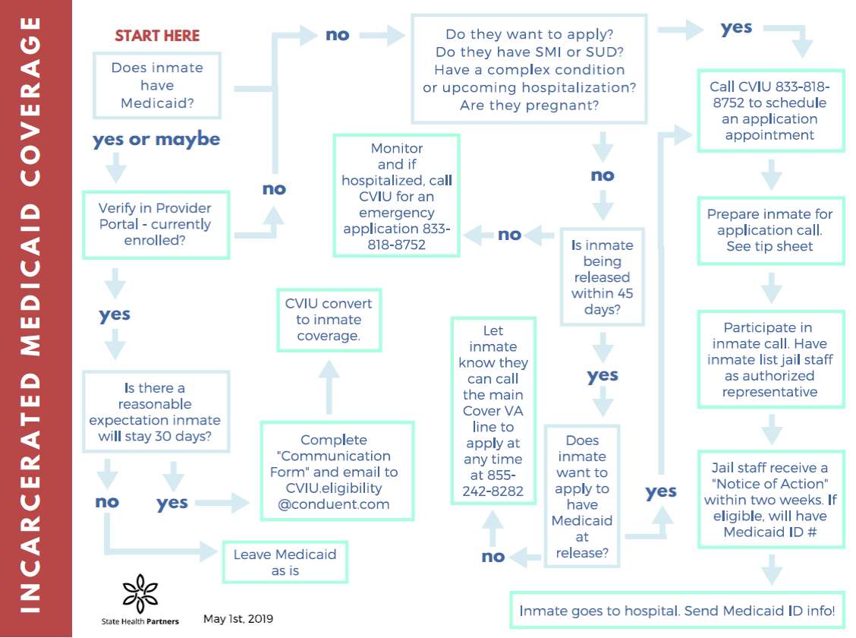
2019 Medicaid Application Process

Slide 23

2019 Medicaid Application Process
Application Assister (previously used Authorized Representatives)
Application Assisters are authorized under the Affordable Care Act (ACA) to provide assistance with completing Medicaid applications and renewals, and with explaining and helping individuals meet documentation requirements.
They must be authorized by the applicant. Jail staff can serve as Application Assisters for inmates.
The inmate is not required to list a jail staff member as the Application Assister, however, if he does not, the jail will NOT receive any information about the inmate's coverage.
Inmates can list other people as Application Assisters or Authorized Representatives as well.
It is recommended that the jail set up a Medicaid@_insert your email address__.org address for all Application Assisters to use for CVIU correspondence. This way, other staff can check the inbox when an employee is out.
Be sure to keep a list of who is listed as the Application
Assister for which inmate. The CVIU will not speak to
someone other than the Application Assister.
IMPORTANT

Slide 24
Important Information & FAQs
Retroactive Coverage
Medicaid will cover services up to 90 days prior to the date of application.
If a hospitalization occurred within the past 90 days, inmates should apply for Medicaid and the jail staff should inform the call center that the inmate needs Retroactive Coverage.
Once Medicaid is approved, the jail should submit the Medicaid ID number to the hospital and ask them to rebill the inpatient stay to Medicaid.
If the inmate has already left the jail without applying for Medicaid and was hospitalized while incarcerated within the past 90 days:
  Check to see if the individual already had Medicaid (this may surprise you). If the individual has Medicaid, submit the Medicaid ID number to the hospital.
  If the returning individual does not have Medicaid, contact the best contact you have for him/her.
  If you can find him/her, encourage the individual to apply for Medicaid. Otherwise, the individual may be responsible for some or all the outstanding hospital bills.
  If the returning individual will list a jail staff member as an Application Assister, that is helpful. If not, check the Provider Portal to see whether the application has been approved. If so, notate the Medicaid ID number.
  Provide the Medicaid ID number to the hospital and ask that they rebill the services.

Slide 25
Important Information & FAQs
Expedited Coverage for Current Hospitalization
This option can be used if an inmate was unexpectedly hospitalized or is on his/her way to the hospital.
An expedited application request would be appropriate, per DMAS, for an individual not currently enrolled who has an unforeseen and eminent hospitalization.
There will be two different scenarios: (i) those who can apply before going to the hospital, and (ii) those who cannot apply before going to the hospital and need to apply while in the hospital.
Call CVIU at 833-818-8752 and request the Expedited Path for an expedited application. CVIU is committed to processing these applications within 2 business days. (CVIU hours: 8-7 pm M-F) If CVIU is missing information, they will send out a Verification Check List (VCL).
Hospital staff or a jail representative will need to assist with obtaining the inmate’s consent to apply.
Hospital Financial Assistance staff are typically the best options for this.

Slide 26
Important Information & FAQs
Work Release
If the inmate leaves the facility to work but still resides at the jail (i.e., returns to the jail after working each day), he or she can maintain inmate Medicaid status.
The inmate’s earnings, however, will be counted as income and his application should be updated with the CVIU to report new earnings.
This may end Medicaid coverage for some since their income could exceed the maximum allowed amount of $17,237 for an individual.

Slide 27
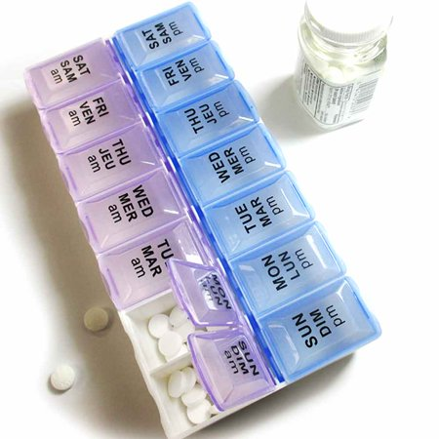
Important Information & FAQs
Medicare:
Individuals with Medicare in jail could also be eligible for Medicaid as an “Aged, Blind, Disabled” enrollee. Medicaid can pay for an inpatient stay for these individuals.
Aged, Blind, Disabled (ABD) Applications:
These applications require verification of financial resources (e.g., bank accounts). Inmates may list a family member or friend who can access this information as an “Authorized Representative.” This will allow CVIU staff to obtain this information from them.

Slide 28
Important Information & FAQs
Emergency Coverage for Non-Citizens
Individuals who meet the requirements for full Medicaid coverage but who do not meet citizenship requirements may be eligible for Medicaid coverage of limited emergency treatment.
Follow the same application process as with Standard Applications. DMAS’ Division of Program Operations will review the medical evidence for a determination of the medical emergency and the duration of the emergency services certification period.
Below is the information the CVIU will need from the hospital or treating physician (for each period of service):
        On the Emergency Medical Certification Form, specify the exact dates of service requested. Ask for a phone number where the person can be reached.
      Emergency room record, admission (admit) orders, history and physical, MD notes. discharge summary, operative notes;
      Operative consent form;
      Pre-operative evaluation;
      Labor and delivery notes, if pregnancy related; and
      Dates of service – admission date/discharge date.

Slide 29
Important Information & FAQs
Emergency Coverage for Non-Citizens
(continued)
The CVIU will send the emergency treatment verification to DMAS for review. If approved, DMAS will provide the certification for Medicaid payment for emergency services and coverage begin and end dates.
Once an eligibility period is established, additional requests for coverage of emergency services within 6 months will not require a new Medicaid application. However, each request for Medicaid coverage of an emergency treatment requires a new, separate certification and a review of the alien’s income and resources and any change in situation that the alien reports.

Slide 30
Important Information & FAQs
Unable to Participate on the Call due to Functional Limitations, but Willing to Apply:
  The telephonic process is STRONGLY preferred but, the individual may apply through CommonHelp if the facility has internet access for inmates. They MUST identify that the individual is incarcerated on the application. (http://www.commonhelp.virginia.gov/)
  If internet access is not an option, the inmate may fill out a paper application, sign, and have it faxed to 888-221-9402. Please indicate the application is for the “CVIU.”
Applicant has a serious mental illness and unable to consent to apply:
  The applicant would need approval from a legal guardian to be able to apply.
Non-Virginia Residents at Time of Incarceration:
  If an inmate is from another state but in a Virginia jail, he or she can be considered a Virginia resident for purposes of Virginia Medicaid. There is no waiting period for residency.

Slide 31
Important Information & FAQs
Current Medicaid when Entering Jail
If the inmate is expected to stay more than 30+ days, proceed with updating his/her coverage.
A full application is not needed however, the inmate’s Medicaid coverage must be partially reviewed to change the aid category from a full coverage aid category to an incarcerated aid category.
If the jail has the Medicaid ID number, jail staff should call the CVIU and inform them that the individual is in their custody so the aid category may be changed. CVIU staff do not need to speak with the inmate directly.
If you do not have the Medicaid ID number, the inmate will likely need to join on the call.

Slide 32
Important Information & FAQs
Renewing Medicaid
Each year, Medicaid must be renewed.
CVIU will process renewals for any individual with active Medicaid coverage. If additional information is required from the individual, a Verification Check List (VCL) will be sent to the facility address to obtain the necessary information.
If the CVIU is able to verify that the individual is still incarcerated, then an ex parte renewal will be completed and the jail will be notified that their coverage is renewed.
Please let the CVIU know to whom they should send the monthly renewal spreadsheet. The CVIU will then send a spreadsheet of everyone who needs to be renewed to verify that they are still there.
CVIU will then process the renewal using the ex parte process. This means that for renewals, the inmate does not need to sign anything or participate in a call with the CVIU.
Once the renewal evaluation is complete a Notice of Action will be sent to the jail facility address.
For pregnant women, the jail should notify the CVIU when she has had her baby. At the end of her postpartum period, the CVIU will move her to an incarcerated group.
For aged individuals or people with Medicare, the jail will need to contact the CVIU for a phone-based renewal with the inmate. They need to be evaluated under the disabled group.
Transfers Between Jails or to a DOC Facility:
Currently, this information is not needed at the time it occurs. The address will be updated at the next annual renewal.

Slide 33

Important Information & FAQs
Going to the Hospital
How will Hospitals Handle the Bill?
The hospital should submit claims for inpatient charges the same way it would submit any other Medicaid fee-for-service claim. The bill should not go to the jail first.
Going to the Hospital
When an inmate goes to the hospital, if the inmate has Medicaid, the jail should provide the Medicaid identification number to the hospital.
If the inmate does not have Medicaid, call the CVIU and request the “Expedited Path” for expedited coverage as soon as possible. Once you have the Medicaid ID number, provide it to the hospital. Hospital staff may need to assist with obtaining the inmate’s consent to apply.

Slide 34
Important Information & FAQs
Going to the Hospital (cont.)
When an inmate is sent to the hospital but later applies for Medicaid, how will the jail get reimbursed for the hospital stay?
It is strongly recommended that jails make every effort to have inmates apply for Medicaid before, during, or as soon possible after a hospitalization.
In the event the inmate is discharged from the hospital before a Medicaid application is completed, provide the Medicaid ID number to the hospital. The hospital may be able to adjust the bill prior to being sent.
Bills for Services during Retroactive Period: provide the Medicaid ID number to the hospital and ask that they resubmit the claim to Medicaid.
Bills for Services during Retroactive Period that the Jail already PAID: the jail should obtain an authorization from KEPRO (804-452-5450) and then submit the claim with the authorization to DMAS.
            Department of Medical Assistance Services
            P.O. Box 27443
            Richmond, Virginia 23261-7443
If the date of service has reached a timely filing constraint (12 months from the date of service) the jail should attach the retro letter for proof of timely filing.

Slide 35

Important Information & FAQs
Appealing a Denied Service
The appeal should be submitted as a “Client Appeal.”
The “Authorized Representative Form” for a jail staff member should be submitted with the appeal. This needs to be signed by the inmate.
The “Authorized Representative Form” for a jail staff member should be submitted with the appeal. This needs to be signed by the inmate.
An in-person hearing is not necessary.
Appeal Forms and information can be found at: http://www.dmas.virginia.gov/#/appealsresources

Slide 36

Important Information & FAQs
Reentry
Jails can begin Medicaid pre-release planning 45 days prior to release.
For inmates who have Medicaid while incarcerated:
If inmates leave with incarcerated coverage, the only service Medicaid will pay for in the community is a hospital stay. But incarcerated coverage cannot automatically be switched to community coverage.
Medicaid eligibility must be reevaluated (partial review) to redetermine the household size and document whether there is additional income (e.g., from a spouse or children).
Please complete the “Communication Form” and send to CVIU. The Communication Form will ask for the Medicaid ID number, future address, people in the new household, and the projected release date.
Be SURE to include new household information –
Otherwise at this time coverage will be terminated.

Slide 37
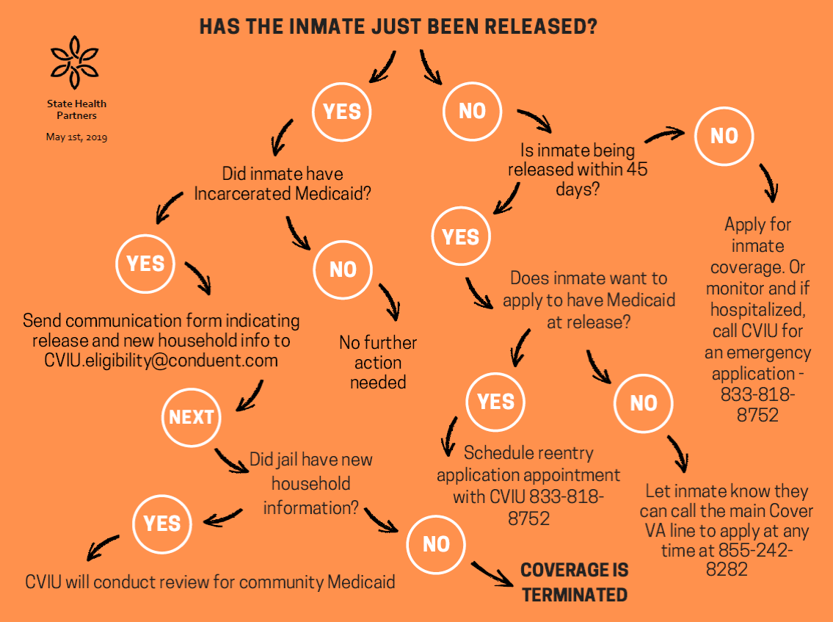
Important Information & FAQs
Reentry

Slide 38



Accessing Medicaid Eligibility Information
Using the Medicaid Provider Portal
check online to see if someone has Medicaid
See what type of Medicaid coverage it is
Obtain the Medicaid ID number

Slide 39
Accessing Medicaid Eligibility Information
Using the Medicaid Provider Portal
Detailed Instructions for gaining access to the Medicaid Provider Portal:
  www.statehealthpartners.com
  Under “Client Login” go to “DMAS and Jails”
  The password is: MEDICAID
  Instructions are under the heading “Accessing Medicaid ID Numbers”
To access the system, jails must get an “Atypical Provider Identification Number” (API).
You will be applying for an API as a “Consumer Directed or CD Services Facilitator.” Note- while jails are not these types of providers this is the selection you should make.
You will probably want the Superintendent to be listed as the Administrator “applying” for access.
It takes about an hour of staff time to complete the applications, and up to 10 days for the system to provide you with the API.
Once you have the API you can access the Medicaid Provider Portal.

Slide 40
1st Apply for a Provider ID Number

Slide 41
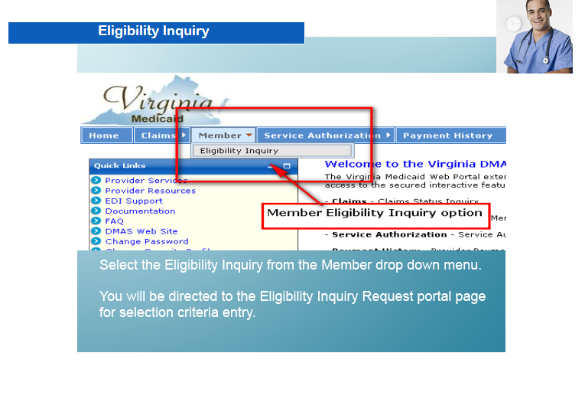
Then Access DMAS Medicaid Web Portal

Slide 42
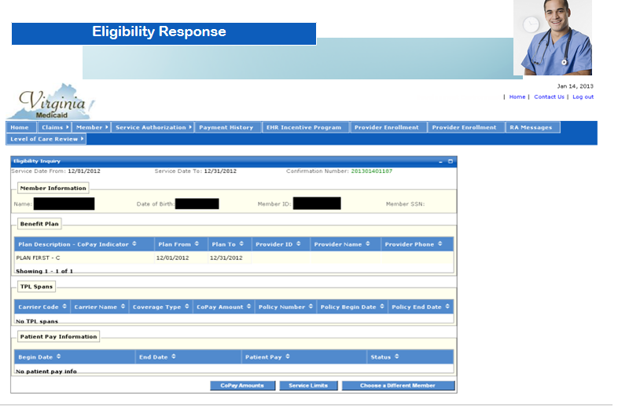
DMAS Medicaid Web Portal

Slide 43
Work in Process
Data Exchange is still in development.
Reentry – Policy considerations to encourage continued coverage upon release.

Slide 44
Resources
Cover Virginia Incarcerated Unit (CVIU)
833-818-8752
Eligibility questions/case status: cviu.eligibility@conduent.com
To schedule/change appointments: docappointments@conduent.com
www.coverva.org/cviu/
Raynette Adams
Medicaid Corrections Liaison, DMAS
Raynette.Adams@dmas.virginia.gov
Raynette.Adams@conduent.com
(804)967-2985
Cover Virginia – for Medicaid Applications in the Community
855-242-8282

Slide 45


T
H
A
N
K
Y
O
U
Thank You!
Suzanne S. Gore, JD, MSW
Principal
suzanne.gore@statehealthpartners.com
804-212-9994
StateHealthPartners.com

